Slide 1

Heart Attack Risk Prediction Using Machine Learning
Classifying heart attack risk from health data.
Eldad Winter & Oran Nuriel

Slide 2

Project Information
1
Dataset Source
Heart Attack Prediction Dataset by Sourav Banerjee on Kaggle.
2
Dataset
This dataset contains health and lifestyle information about individuals, with a focus on identifying factors that may contribute to heart attack risk. The data includes 8,763 records and 26 features related to demographics, medical history, and lifestyle habits.
Objectives
3
The goal of this project is to analyze and model the factors contributing to heart attack risk. By applying exploratory data analysis (EDA) and machine learning, we aim to:
Identify key indicators associated with increased heart attack risk.
Build a predictive model to classify individuals as at risk or not at risk of heart attacks based on the provided features.

Slide 3
Column Explaining
Patient ID - Unique identifier for each patient
Age - Age of the patient
Sex - Gender of the patient (Male/Female)
Cholesterol - Cholesterol levels of the patient
Blood Pressure - Blood pressure of the patient (systolic/diastolic)
Heart Rate - Heart rate of the patient
Diabetes - Whether the patient has diabetes (1: Yes, 0: No)
Family History - Family history of heart-related problems (1: Yes, 0: No)
Smoking - Smoking status of the patient (1: Smoker, 0: Non-smoker)
Obesity - Obesity status of the patient (1: Obese, 0: Not obese)
Alcohol Consumption - Level of alcohol consumption (None, Light, Moderate, Heavy)
Exercise Hours Per Week - Number of exercise hours per week
Diet - Dietary habits (Healthy, Average, Unhealthy)
Previous Heart Problems - Previous heart problems (1: Yes, 0: No)
Medication Use - Medication usage (1: Yes, 0: No)
Stress Level - Self-reported stress level (1-10)
Sedentary Hours Per Day - Hours of sedentary activity per day
Income - Income level of the patient
BMI - Body Mass Index (BMI) of the patient
Triglycerides - Triglyceride levels of the patient
Physical Activity Days Per Week - Days of physical activity per week
Sleep Hours Per Day - Hours of sleep per day
Country - Country of the patient
Continent - Continent where the patient resides
Hemisphere - Hemisphere where the patient resides
Note: Per request, Country and Continent columns will not be used in this project.

Slide 4




EDA
Imbalanced Data
Correlation Analysis
Examined feature correlations with heart attack risk.
Features Values Distribution

Slide 5
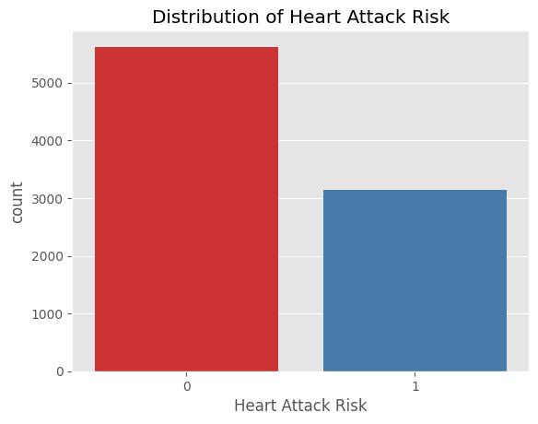
Imbalances Data
The target variable, Heart Attack Risk, is slightly imbalanced.
Suggesting we might apply SMOTE (Synthetic Minority Over-sampling Technique) to balance classes, enhancing model performance on minority cases.

Slide 6
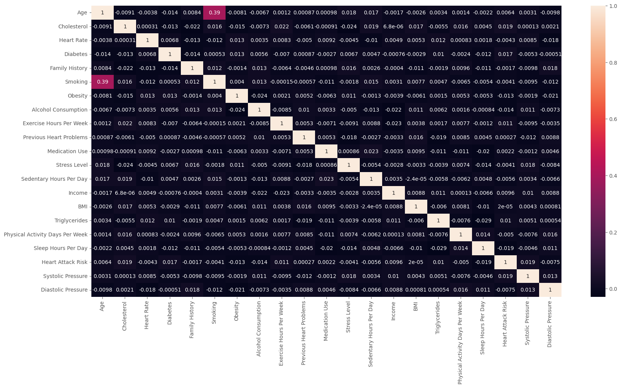
Correlation Matrix
The minimal correlations imply that no single feature in this dataset stands out as a strong predictor of heart attack risk.

Slide 7
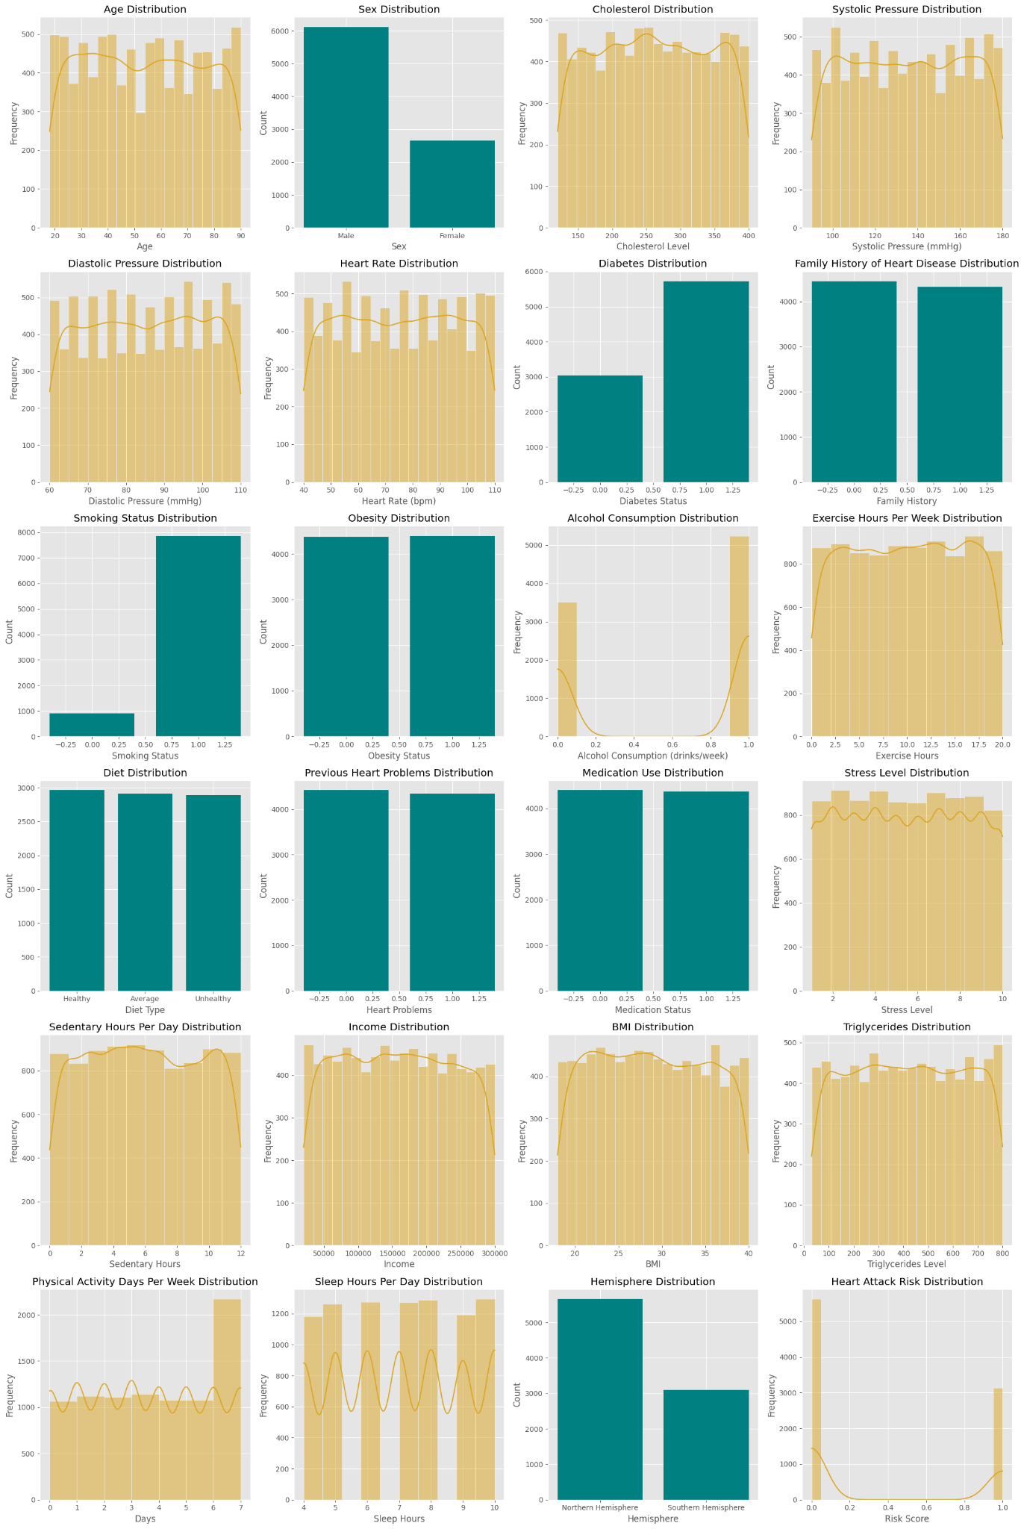
Features Values Distribution

Slide 8
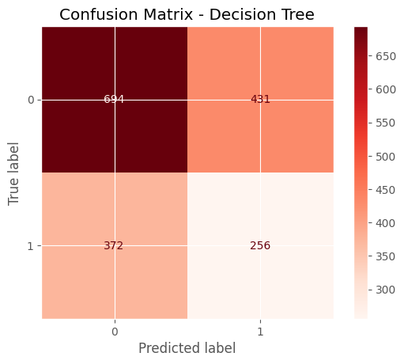
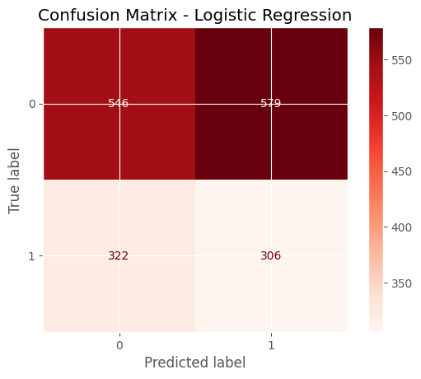
Basic models pipeline
Accuracy: 0.54
Recall: 0.41
F1 Score: 0.39
Accuracy: 0.49
Recall: 0.49
F1 Score: 0.40

Slide 9
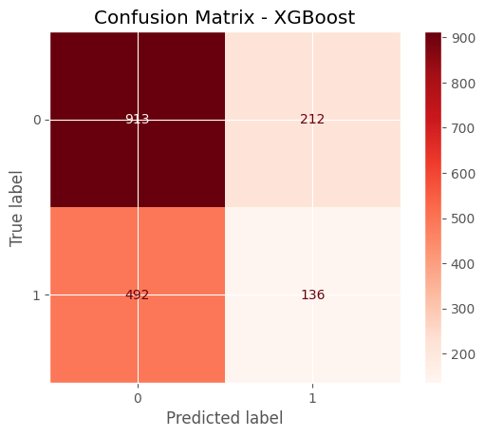
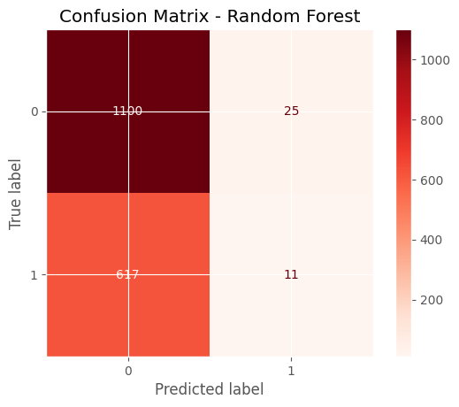
Basic models pipeline
Accuracy: 0.60
Recall: 0.22
F1 Score: 0.38
Accuracy: 0.63
Recall: 0.02
F1 Score: 0.03

Slide 10
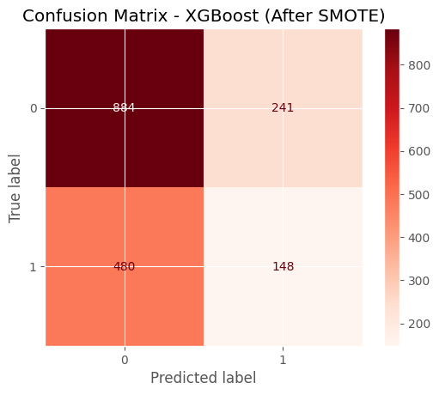
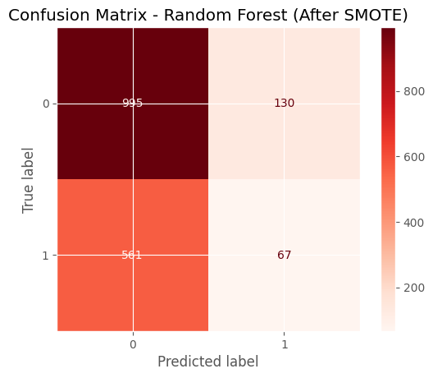
Improved models pipeline - SMOTE
Negligible improvement for XGBoost & Random Forest
Accuracy: 0.59
Recall: 0.24
F1 Score: 0.29
Accuracy: 0.61
Recall: 0.11
F1 Score: 0.16

Slide 11
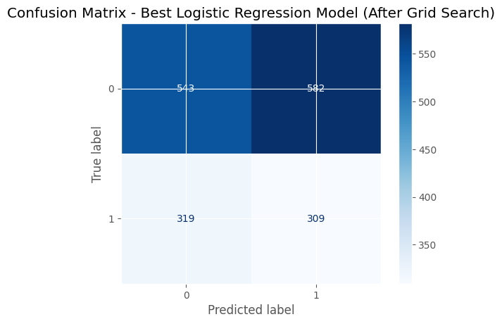
Logistic regression
Hyperparameter tuning (Grid Search)
The Final Results
Accuracy: 0.49
Recall: 0.49
F1 Score: 0.5

Slide 12

Conclusions and Future Work
Key Findings
Logistic Regression performed best after optimization.
Why we choose it ?
We chose the model with the best recall values because identifying individuals at risk is our top priority, and recall helps ensure we minimize false negatives, thereby correctly detecting those who need intervention
Important Features
Cholesterol and blood pressure crucial for prediction.

